Slide 1
html/javascript/css Supplements
Just Getting Around

Slide 2
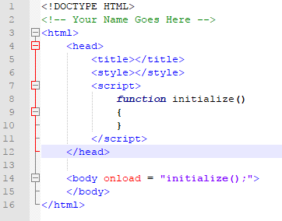
The Template
Start with your basic HTML Template

Slide 3
onload
The onload attribute is an event that the page can respond to.
As its value, we assign Javascript code. In this case, a function call.
The page will call the function initialize() as soon as it loads.

Slide 4
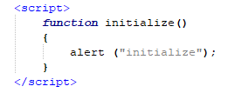
Alert!!!!!
If you add an alert() to the initialize() function and run the page, your message will appear.
Using alerts is a common way to trace and debug code that doesn’t seem to be working properly.

Slide 5
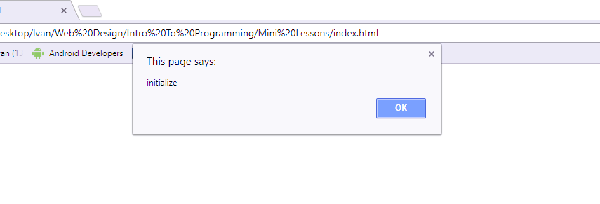
Alert!!!!!
When you load the page, it calls the function initialize(), which pops up the alert.

Slide 6
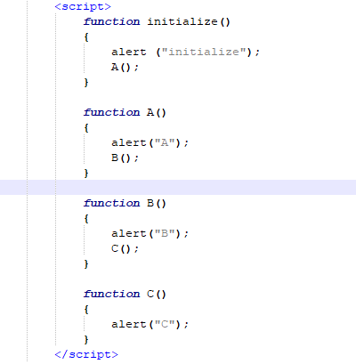
Sequence of execution
When you write a program, you determine the sequence of execution by creating and calling functions as necessary.
As you step into a function, it executes its lines of code one by one in a top-down style.
If another function call is encountered, the program will immediately jump to that next function.

Slide 7
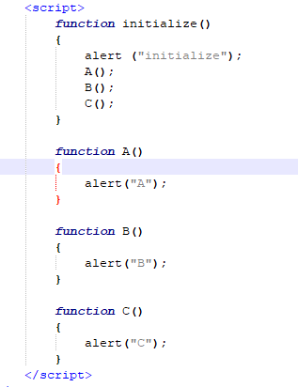
Sequence of execution
How does this code differ in both layout and execution from the previous example?

Slide 8
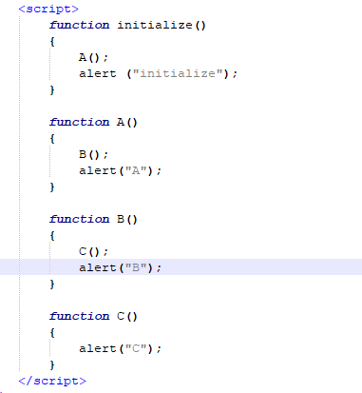
Sequence of execution
How about this?

Slide 9
Sequence of execution
When you write a program, it’s up to you to create a sequence of executions for each of your events.
Though you will likely use the onload event to trigger all of the initialization necessary on your page, you will use other events such as mouse clicks, key presses, and even those you create on your own to trigger the necessary and different executions required by your project.
Organizing and understanding these sequences is vital toward writing a successful program.

